Slide 1
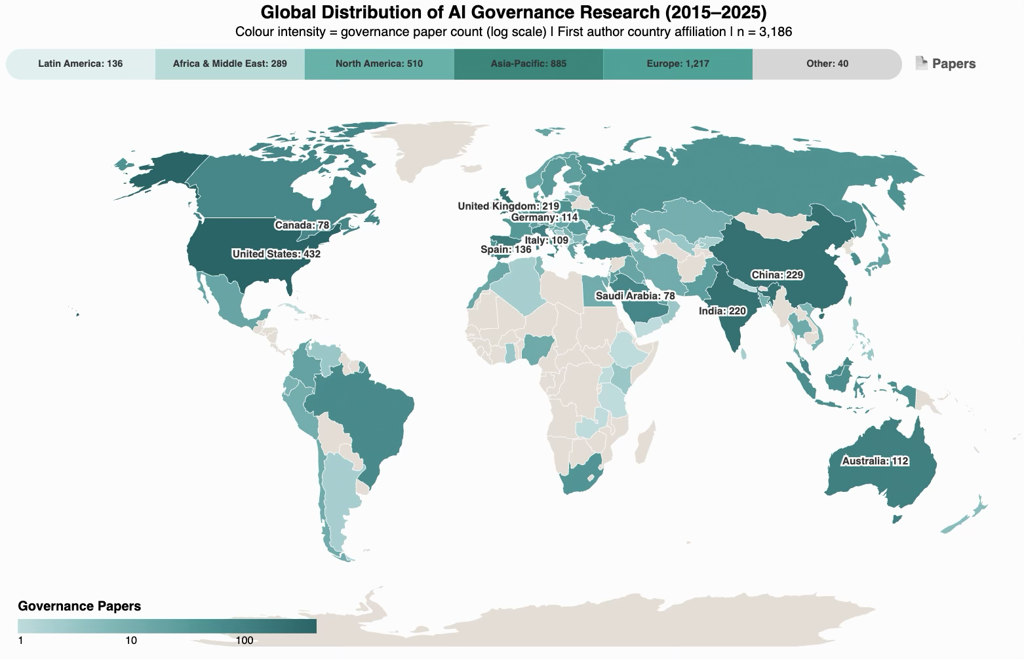
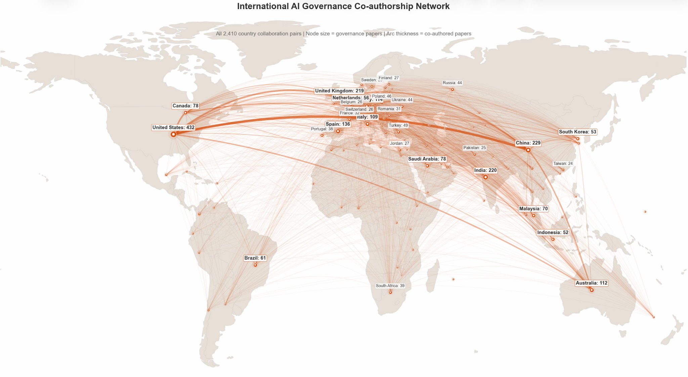
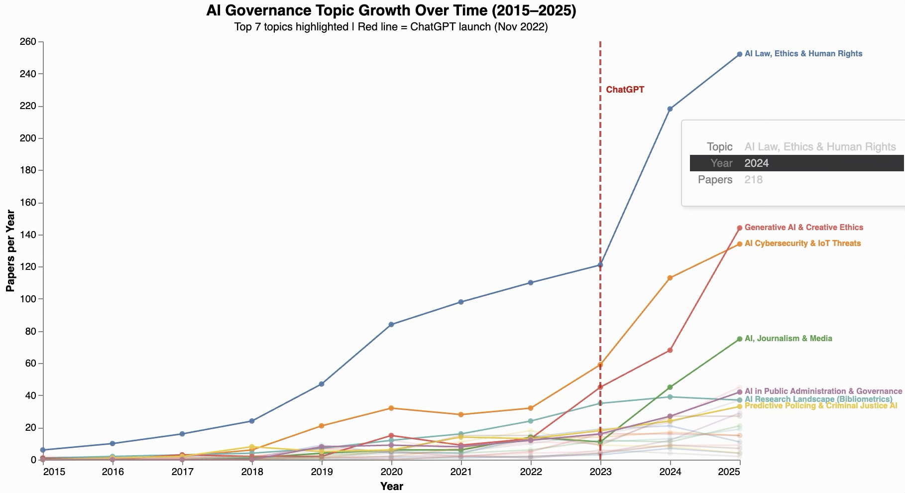
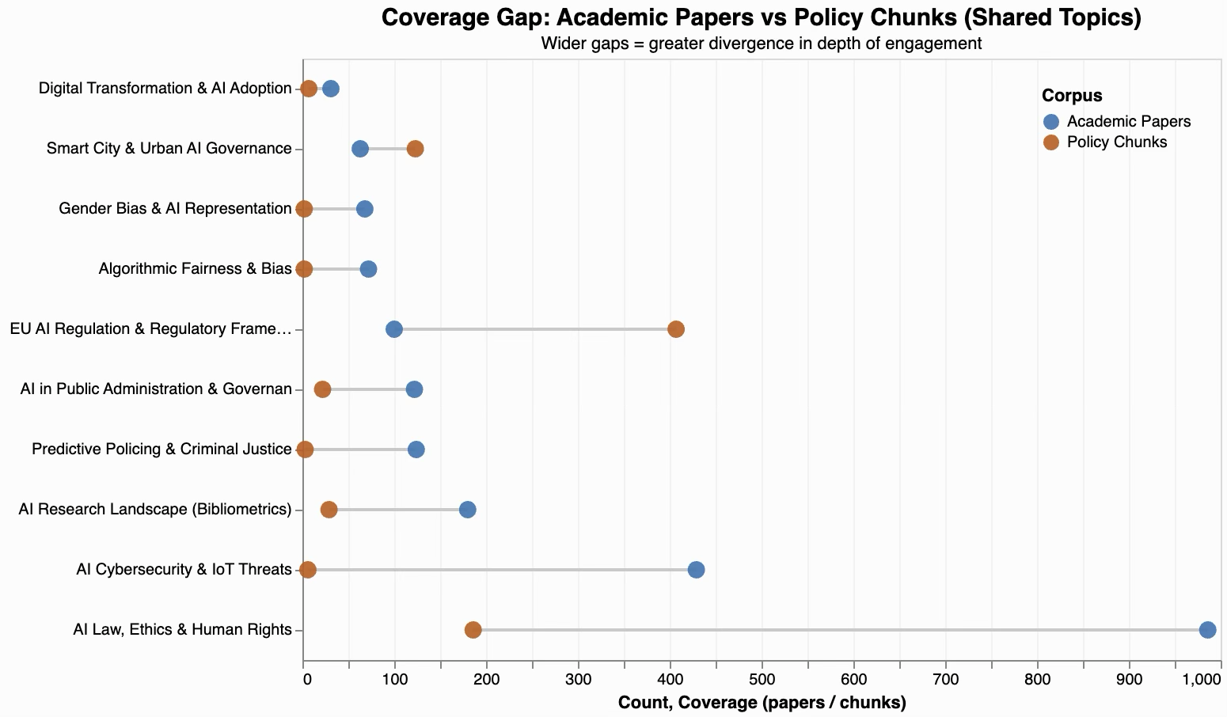
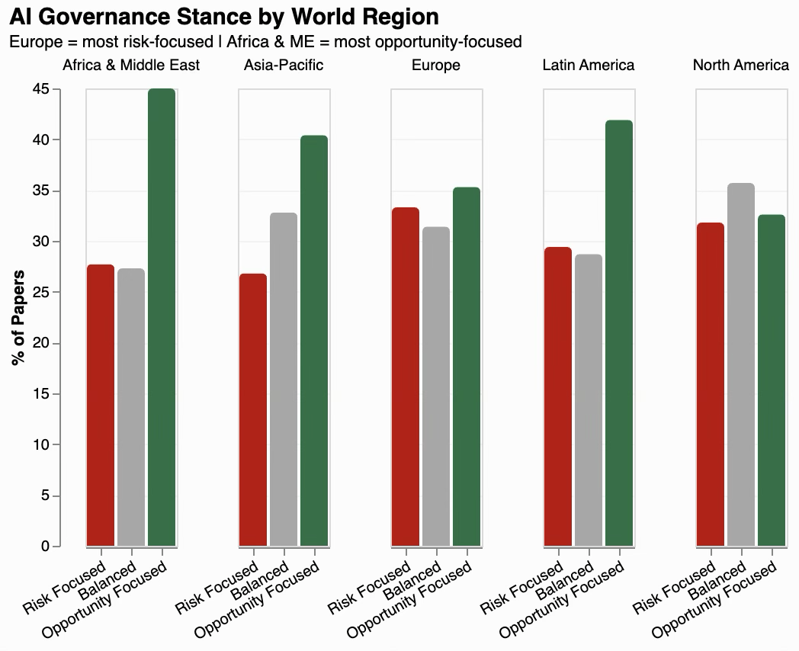
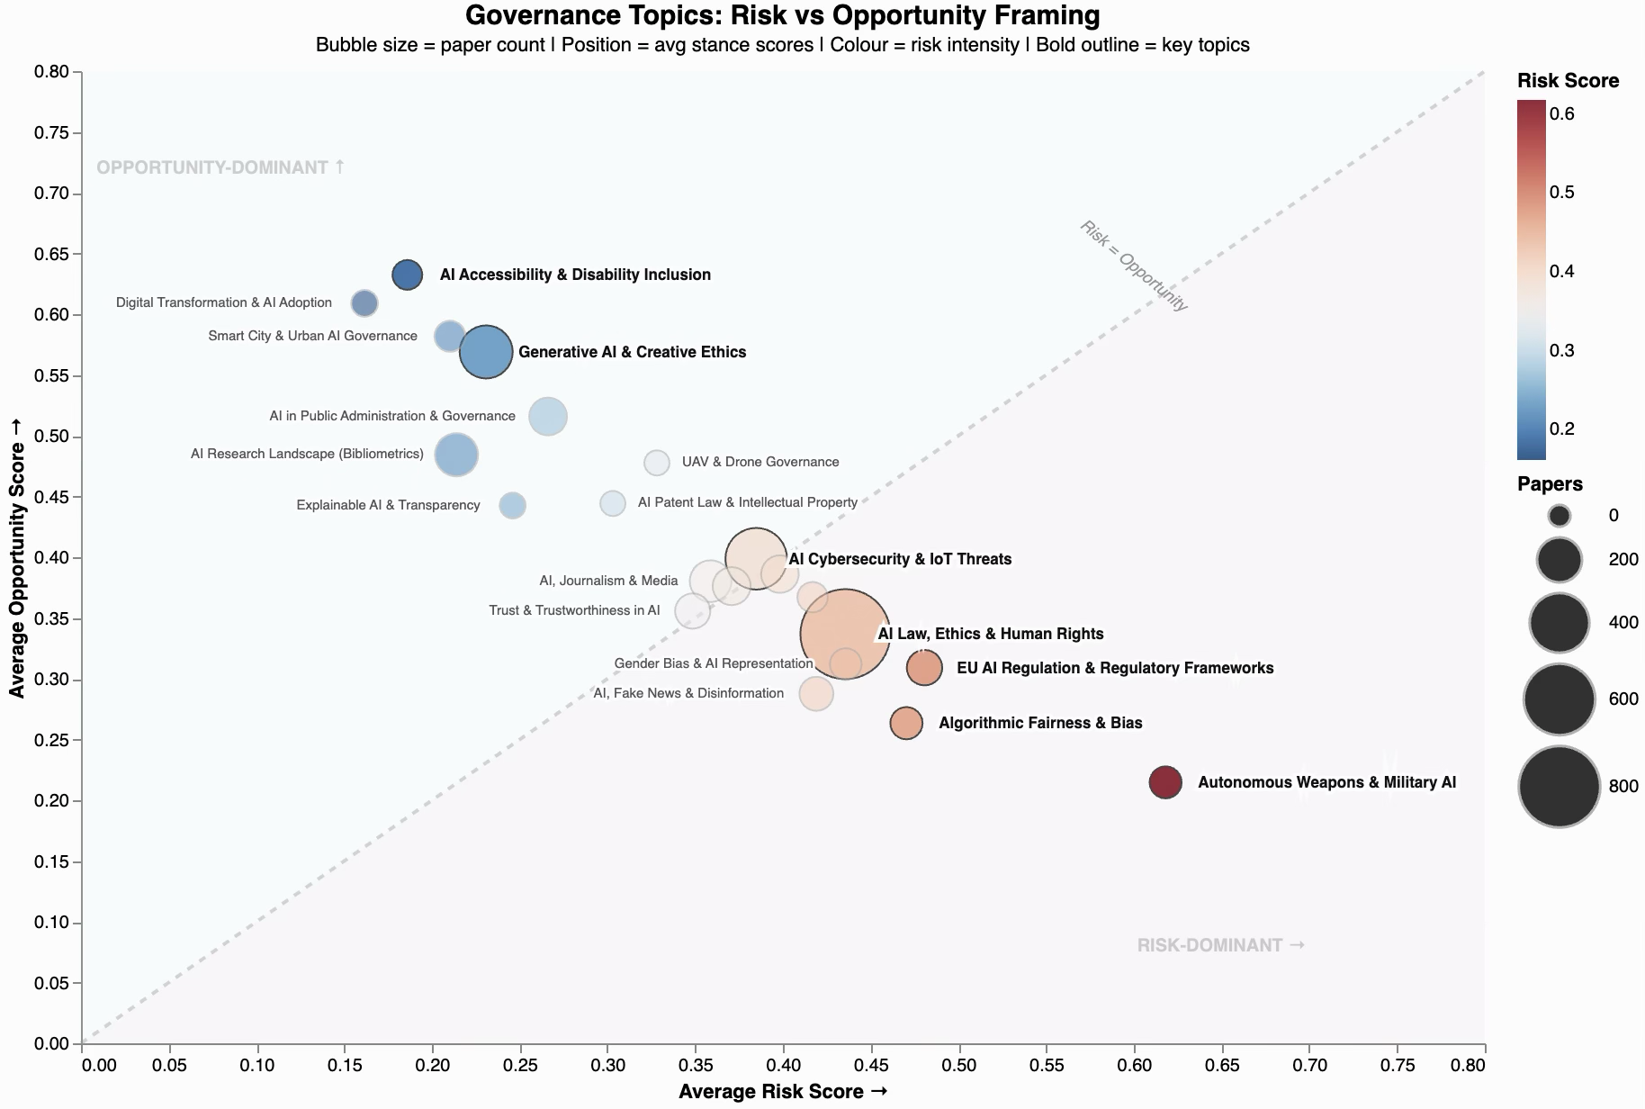
Global AI Governance Narratives:
A Spatial NLP Analysis of Academic and Policy Discourse Tambudzai G. Charumbira, Joshua Gray
Global AI Governance Narratives:
A Spatial NLP Analysis of Academic and Policy Discourse
Tambudzai G. Charumbira, Joshua Gray
Global AI Governance Narratives:
A Spatial NLP Analysis of Academic and Policy Discourse
Tambudzai G. Charumbira, Joshua Gray
Abstract
Results
Key Findings
Contemporary AI governance is shaped by a vast and dispersed body of academic research and national policy frameworks, yet no systematic spatial map exists of how governance concerns are framed across regions and institutions. This study addresses that gap by applying a spatial NLP framework to two complementary corpora: 41,067 peer reviewed AI publications indexed in Scopus (2015 to 2025) and 35 national AI strategy documents and international governance frameworks. Using a two-stage BERTopic pipeline and zero-shot stance classification, we identify 21 governance-relevant themes and examine how they vary across time, regions, institutions, and policy discourse. We find that only 7.8% of AI publications explicitly address governance, that post-ChatGPT governance research expanded rapidly while shifting toward opportunity-focused framing, and that academic and policy discourse align only partially. Across policy corpora, EU AI Act vocabulary emerges as a major global reference point.
Fig1. Europe contributes the largest absolute share of governance papers, while overall output remains concentrated in a relatively small number of countries.
Fig 2. Collaboration is concentrated in a small number of bilateral partnerships, with the China–United States, United Kingdom–United States, and Canada–United States links among the strongest.
Fig 3. Governance research expands sharply in the post-ChatGPT period, strong growth in journalism and media, trust and trustworthiness, gender bias, and algorithmic fairness.
Fig 4. 10 shared topics across academic and policy corpora, while 11 are academic-only indicating partial alignment and a meaningful knowledge-policy gap.
Fig 5. Topic-level stance varies substantially, with autonomous weapons and EU AI regulation more risk-dominated, and accessibility, smart cities, and digital transformation more opportunity-framed.
Fig 6. Framing and topic priorities vary across regions, reinforcing that AI governance discourse is not globally uniform but shaped by distinct institutional and regional contexts.
Figure 1
Figure 2
Data Info
41,067 Scopus publications on AI and governance-related themes, covering 138 countries from 2015 to 2025.
Pre-ChatGPT 2015 to 2021, n = 8,088; Post-ChatGPT 2022 to 2025, n = 32,979.
35 national AI & international governance frameworks across 5 world regions and international bodies.
500-word chunks with 50-word overlap, yielding 1,557 chunks for modelling.
21 governance-relevant topics and 3,186 governance papers, representing 7.8% of the full academic corpus.
40,968 unique institutions geocoded with 99.96% coverage.
Discussion
AI governance research is growing rapidly, but it still represents a small share of the broader AI literature. The post-ChatGPT period saw a sharp increase in governance scholarship alongside a shift toward more opportunity-focused framing, suggesting a move from problem identification toward institutional design. Regional specialization is also clear: Europe leads in absolute output, while Africa and the Middle East show a strong cybersecurity focus and Latin America stands out in journalism and media-related governance research. These patterns suggest that global AI governance is being shaped unevenly, with regional experiences influencing which concerns receive the most attention. Academic and policy discourse also overlap only partially, with several governance concerns remaining academic-only and EU AI Act vocabulary exerting strong influence across policy frameworks beyond Europe.
Figure 3
Figure 4
Methodology
The study uses a two-stage BERTopic pipeline to model governance discourse at scale. After benchmarking candidate embedding models, all-MiniLM-L6-v2 was selected and tuned with UMAP and HDBSCAN. A second BERTopic pass was then used to decompose the large generic catch-all cluster into more meaningful sub-topics. Topics were assessed for governance relevance using OECD, EU AI Act, and UNESCO frameworks. Zero-shot stance classification labelled governance abstracts as risk-focused, opportunity-focused, or balanced, while geographic attribution was derived from first-author institutional metadata.
Grootendorst, M. (2022). BERTopic: Neural topic modeling with a class-based TF-IDF procedure. arXiv:2203.05794.
Jobin, A., Ienca, M., & Vayena, E. (2019). The global landscape of AI ethics guidelines. Nature Machine Intelligence, 1, 389–399.
Ferjani, I., Alzahrani, F.A., & Bouzir, N.M. (2025). Navigating Responsible AI: A Systematic Review of Governance Mechanisms. arXiv.
References
Figure 5
Figure 6

